Slide 1
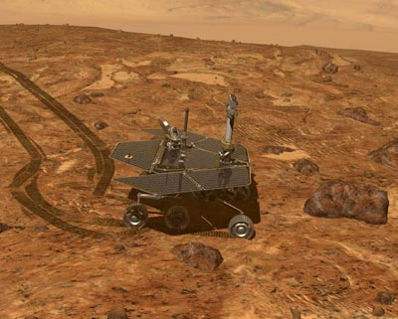
The Rovers are completely independent of the lander they arrived in. They communicate directly back to Earth. This is important, because it means they can move over the surface of Mars for miles without having to stay in range of one place.

Slide 2
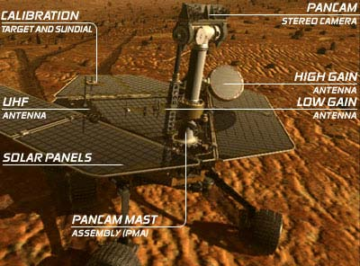
The rovers are powered by solar panels that recharge a battery every day. The panels are expected to become covered in dust, so eventually the batteries will not be able to recharge and the rovers will run down.
The rovers have 3 different communication antennae. The High Gain antenna sends pictures back, the Low Gain antenna uploads instructions from Earth, while the UHF antenna talks to the orbiting MGS and Odyssey spacecraft to help reach Earth.

Slide 3
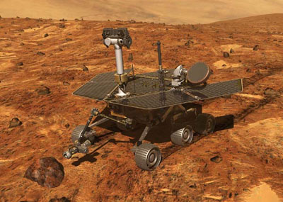
4 are hazard cameras to watch by the wheels.
Each rover has 9 cameras onboard.
Navcams
2 navigation cameras are binocular. They are used to gauge distance to rocks.
Pancams
Front
Hazcams
2 panoramic cameras take 360 color images and thermal images
Rear Hazcams
Microscopic Imager
1 camera is on a microscope

Slide 4
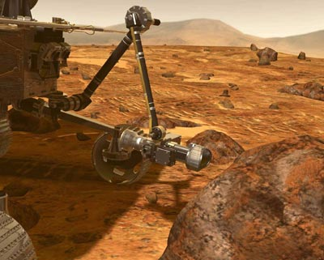
Each rover has four instruments on an extending instrument deployment device, or "arm."
Each device and its use is described in the next 3 slides

Slide 5
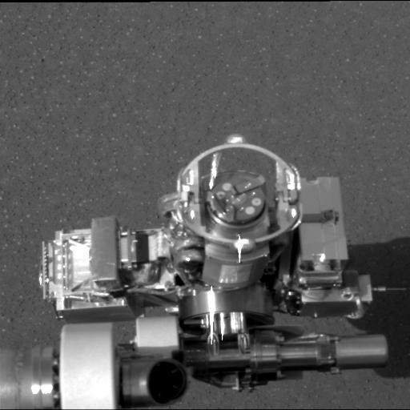
This image taken on Mars shows the rover's rock abrasion tool, also known as "RAT" (circular device in center), located on the rovers' arm. The “RAT” will grind away the outer surfaces of rocks to expose rock interiors for examination by the other arm instruments.

Slide 6
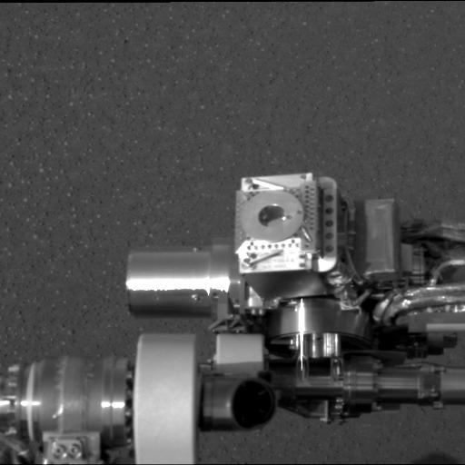
This image shows the rover's Mössbauer spectrometer (circular device in center), located on the rovers' arm. The Mössbauer spectrometer identifies all the different minerals that contain iron. This helps scientists evaluate what role water played in the formation of those minerals.

Slide 7
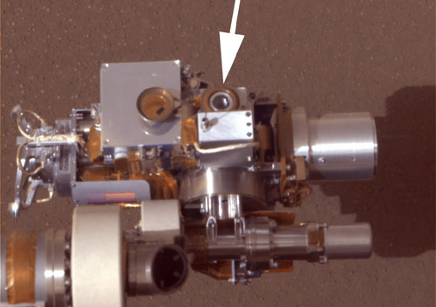
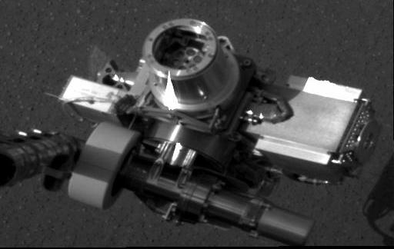
This image shows the rover's microscopic imager (circular device in center). The microscopic imager looks at the fine-scale appearance of rocks and soils.
This image shows the rover's alpha particle X-ray spectrometer (circular device in center). The X-ray spectrometer measures the concentrations of most major elements in rocks and soils.

